Slide 1


BUGZILLA
Subtitle version;
Notes:
NOTE:
To change the image on this slide, select the picture and delete it. Then click the Pictures icon in the placeholder to insert your own image.

Slide 2


Slide 3
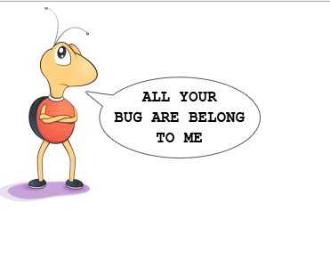

Slide 4
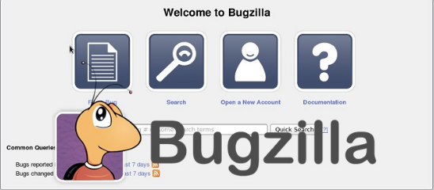

Slide 5
INTRODUCTION WHAT IS BUG ZILLA
Bugzilla is an open-source issue/bug tracking system that allows developers effectively to keep track of outstanding problems with their product. It is written in Perl and uses MYSQL database.
Bugzilla is a defect tracking tool, however it can be used as a test management tool as such it can be easily linked with other test case management tools like Quality Center, Testlink etc.
This open bug-tracker enables users to stay connected with their clients or employees, to communicate about problems effectively throughout the data-management chain.

Slide 6

FEATURES
Advanced search capabilities
E-mail Notifications
Modify/file Bugs by e-mail
Time tracking
Strong security
Customization
Localization

Slide 7
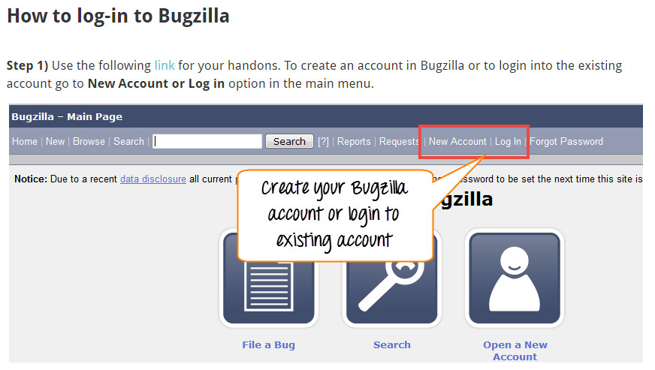
Add a Slide Title - 4

Slide 8
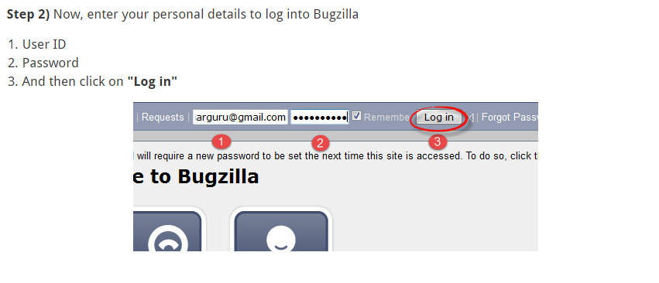

Slide 9
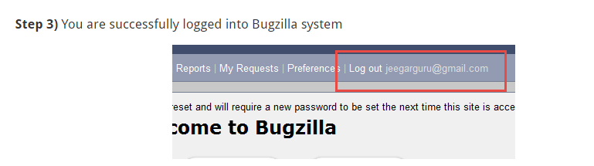

Slide 10

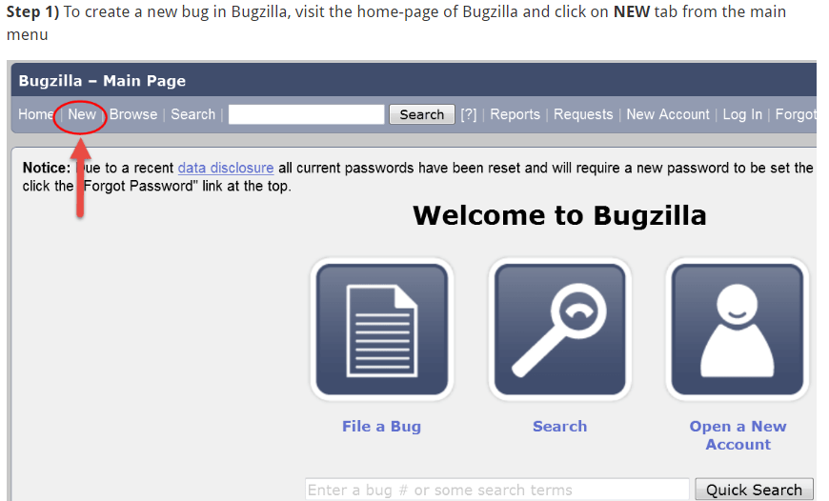

Slide 11
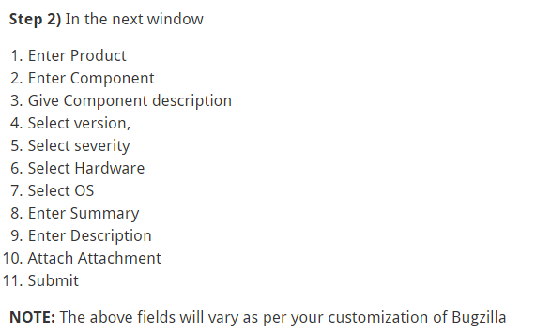

Slide 12
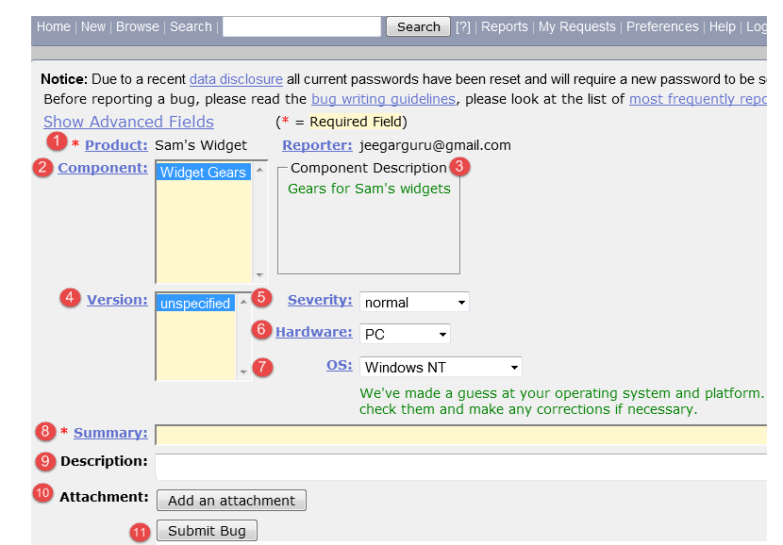

Slide 13
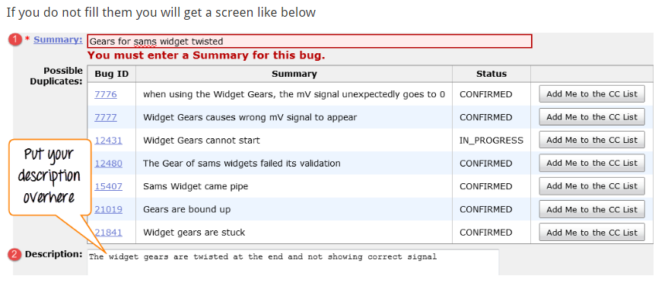

Slide 14
Step 4) Bug is created ID# 26320 is assigned to our Bug. You can also add additional information to the assigned bug like URL, keywords, whiteboard, tags, etc. This extra-information is helpful to give more detail about the Bug you have created.
Large text box
URL
Whiteboard
Keywords
Tags
Depends on
Blocks
Attachments

Slide 15
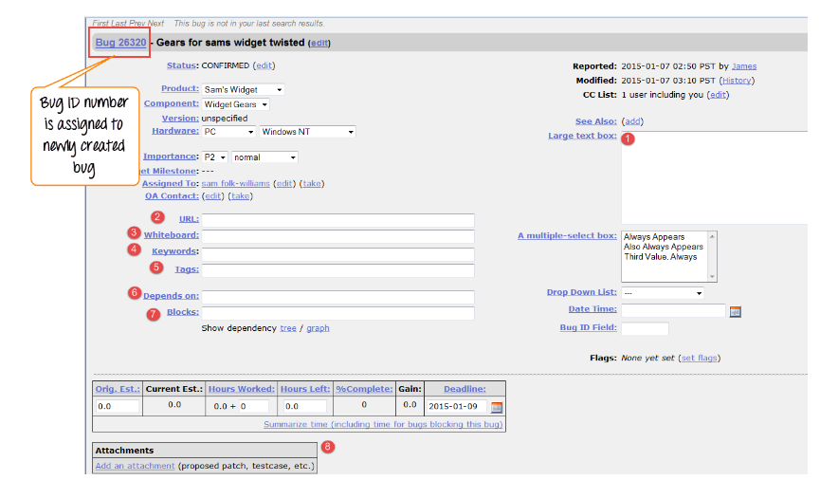

Slide 16
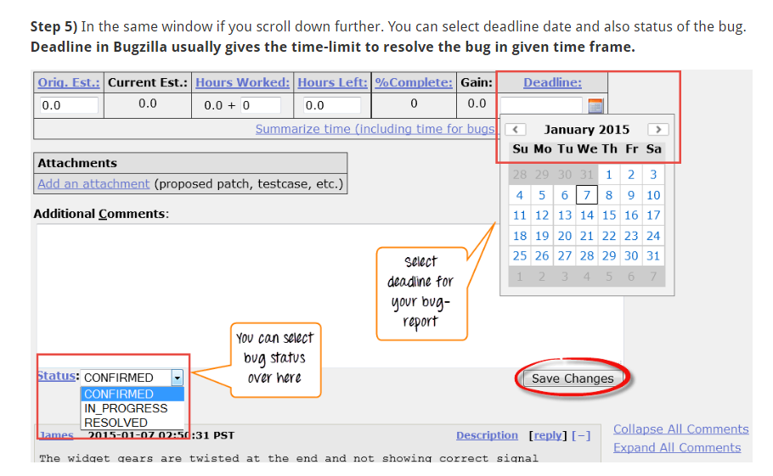

Slide 17
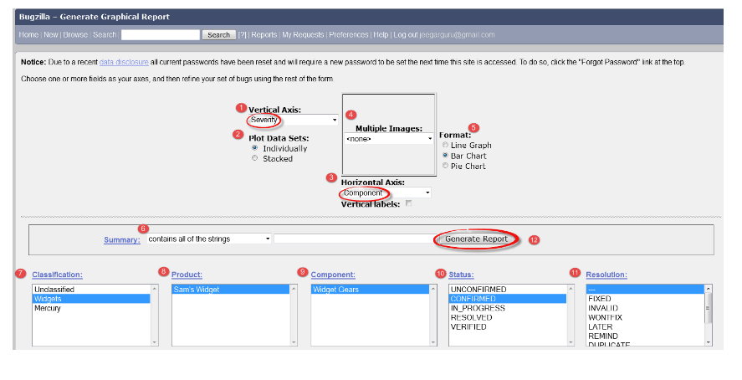
Create Graphical Reports

Slide 18
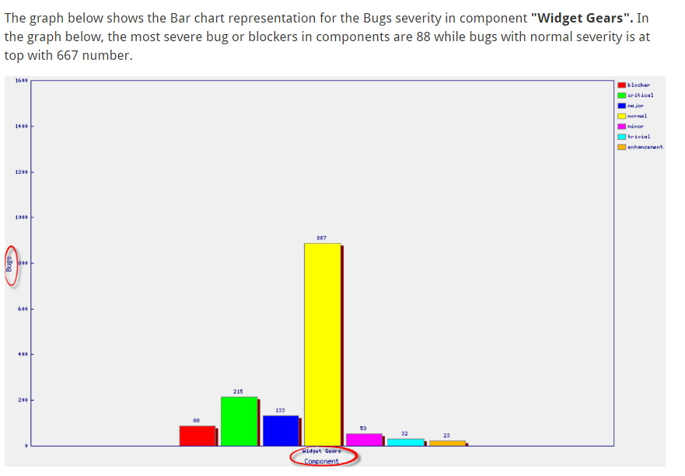

Slide 20
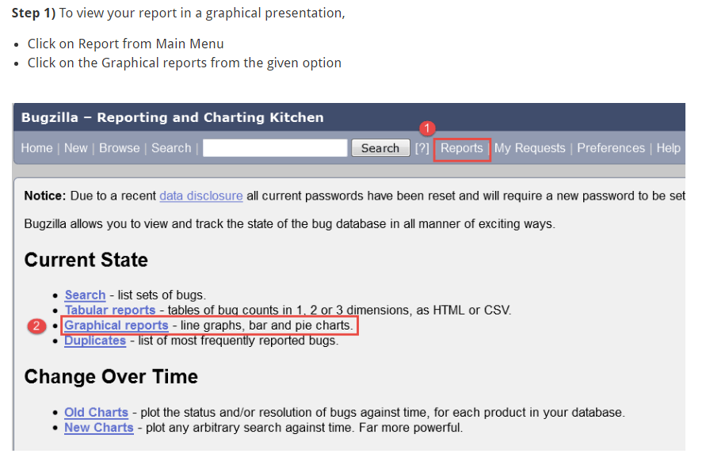

Slide 21
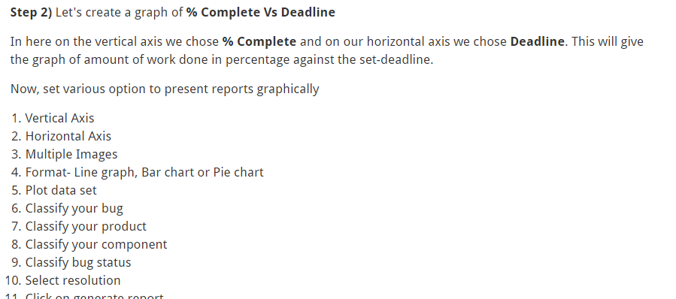

Slide 22
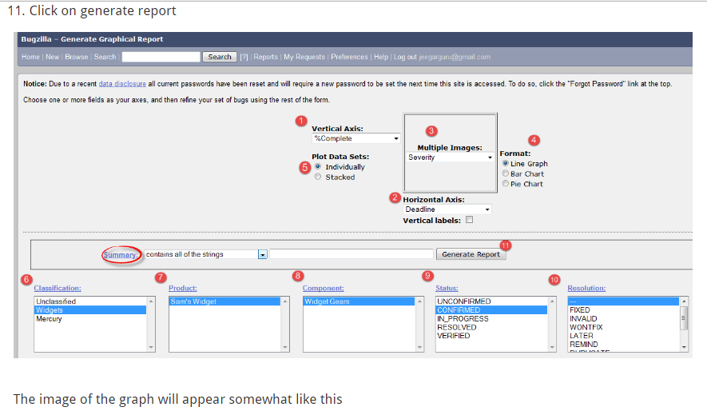

Slide 23
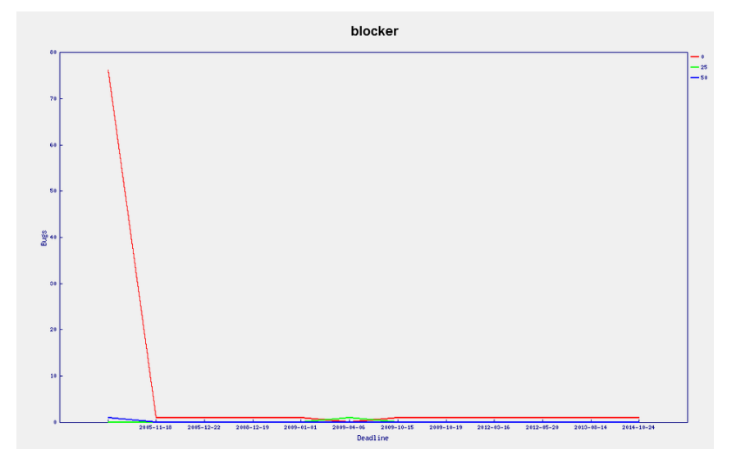

Slide 24
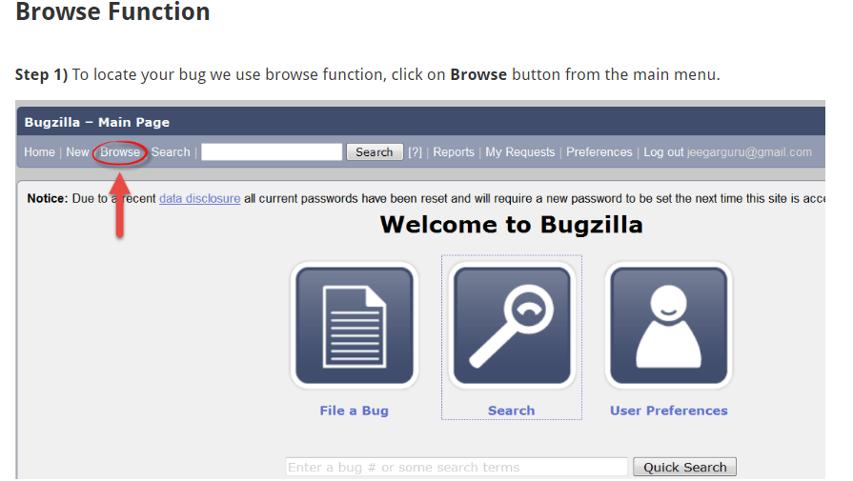

Slide 25
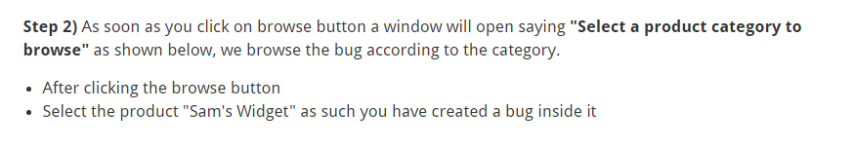

Slide 26
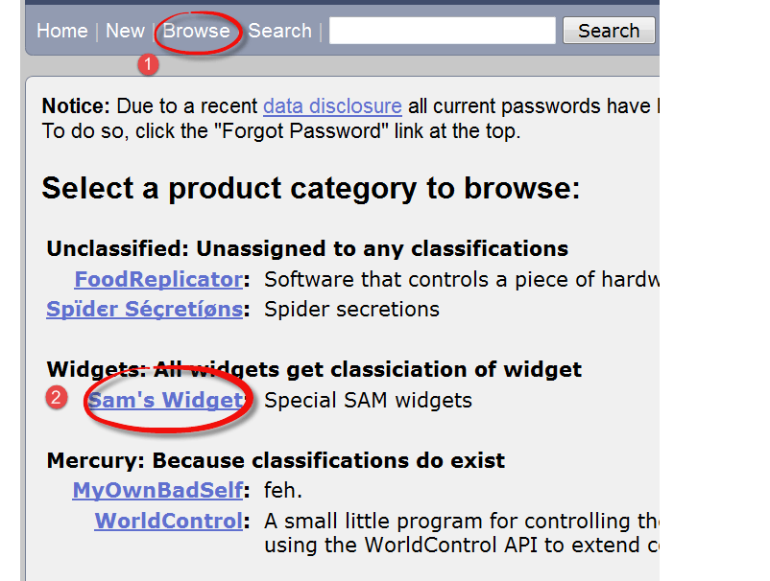

Slide 27
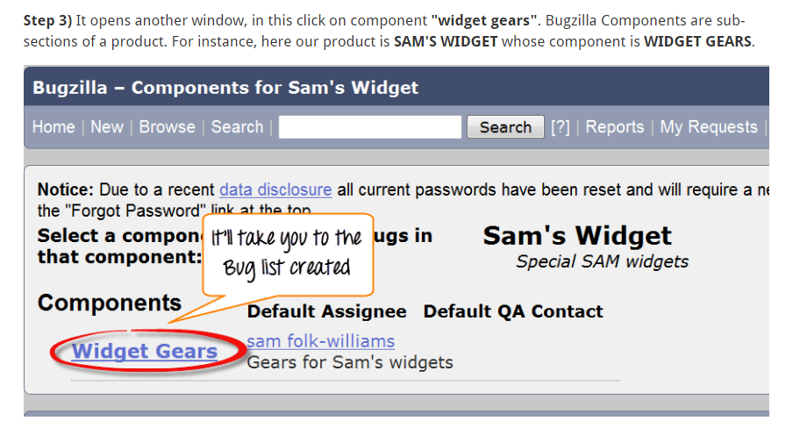

Slide 28
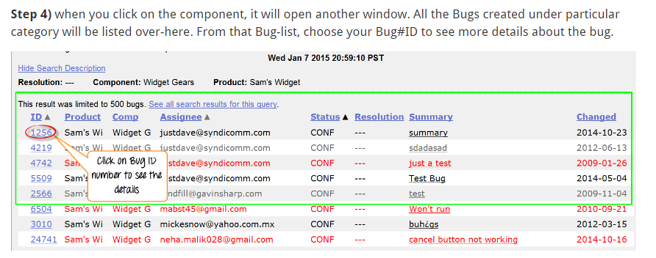

Slide 29
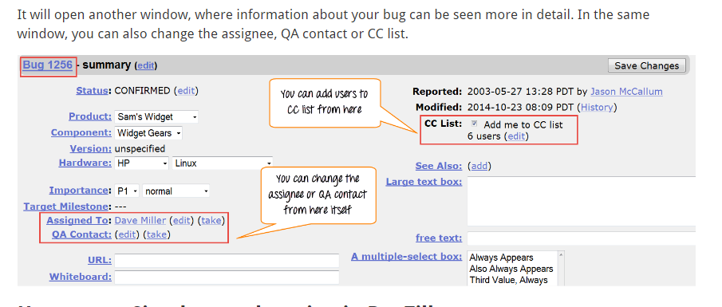

Slide 30
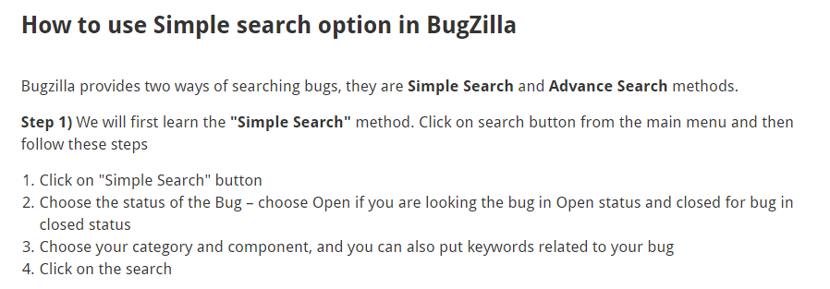

Slide 31
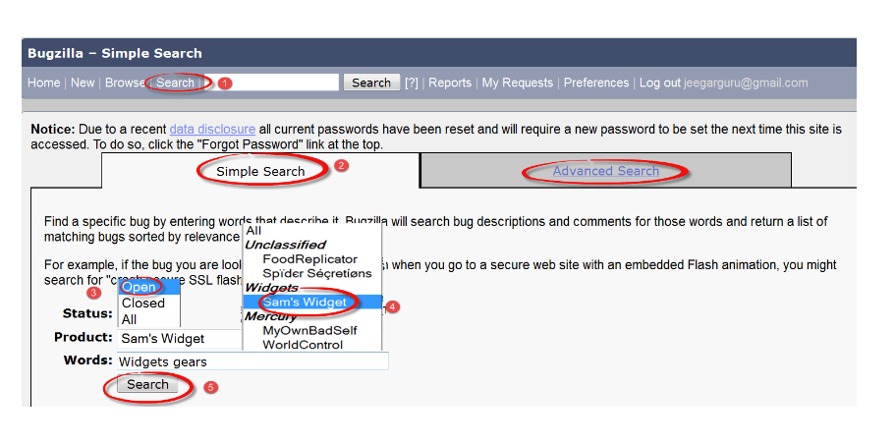

Slide 33
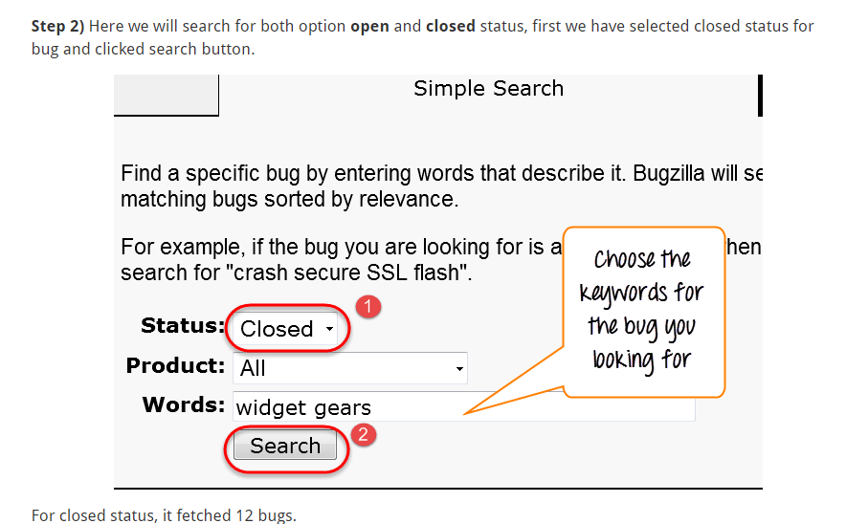

Slide 34
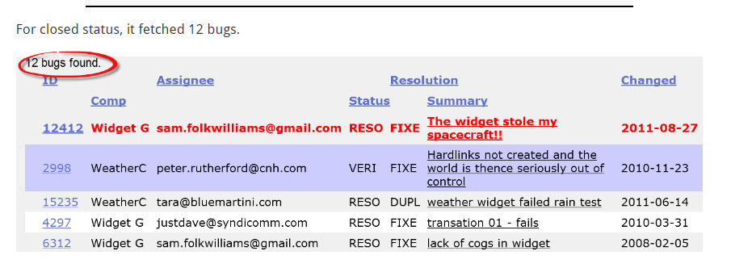

Slide 35
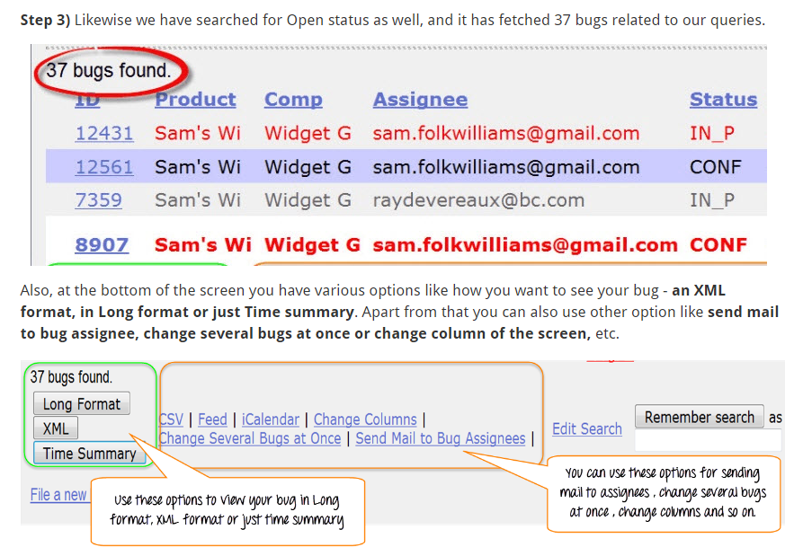

Slide 36
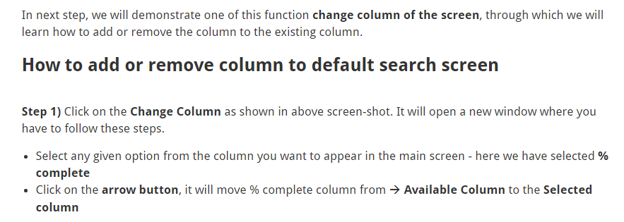

Slide 37
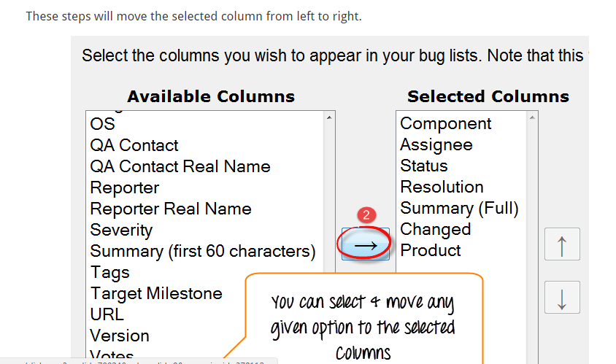

Slide 38
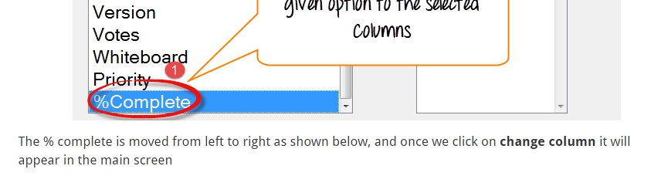

Slide 39
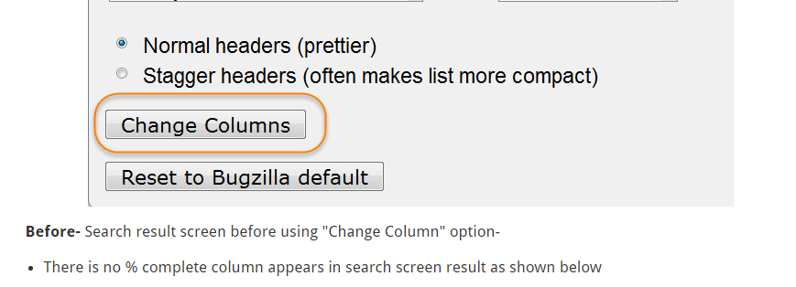

Slide 40
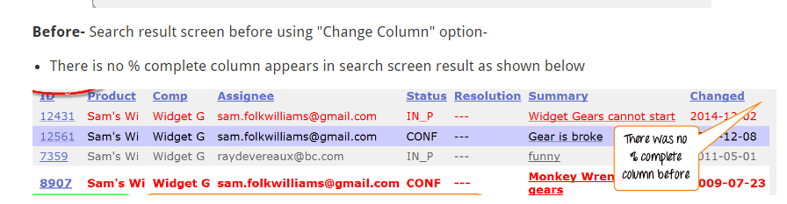

Slide 41
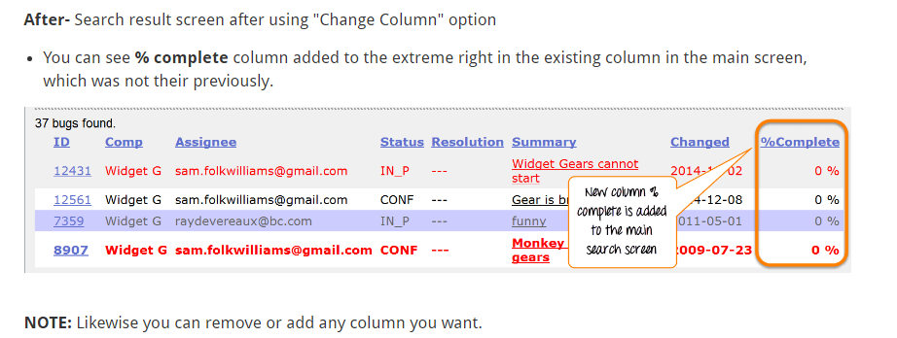

Slide 42
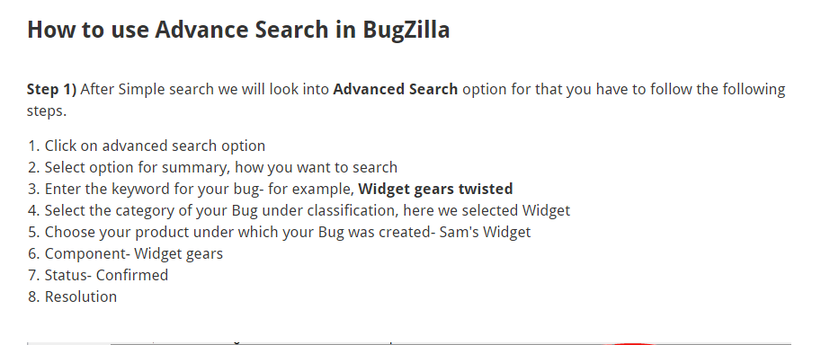

Slide 43
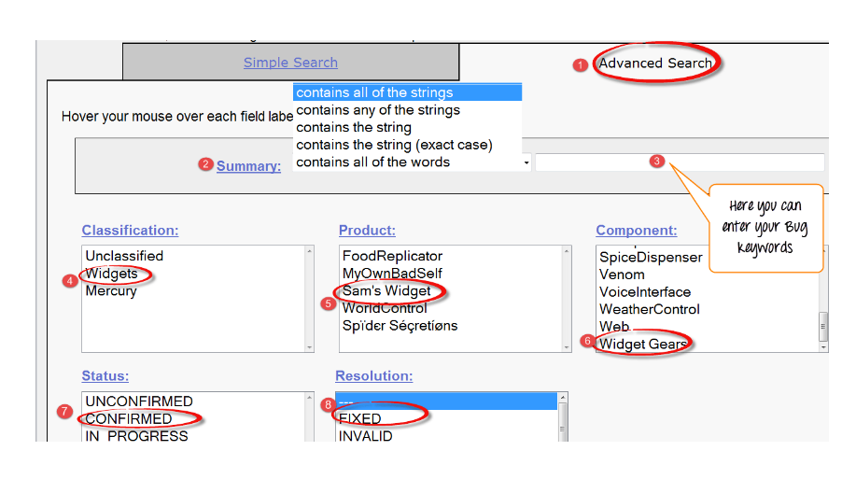

Slide 44
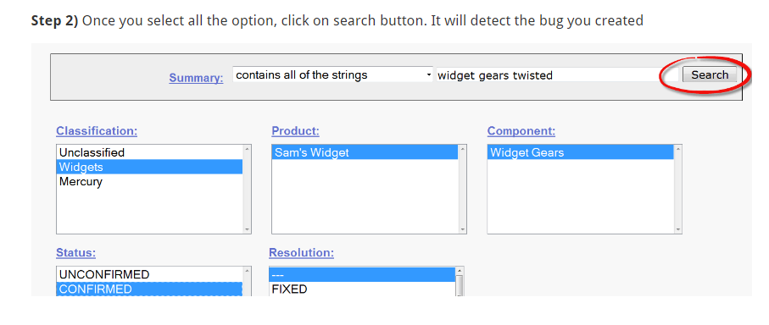

Slide 45
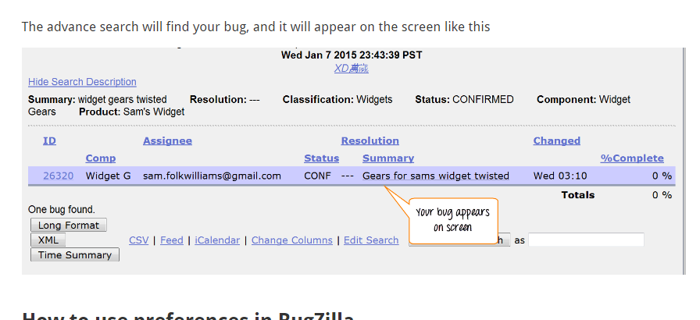

Slide 46
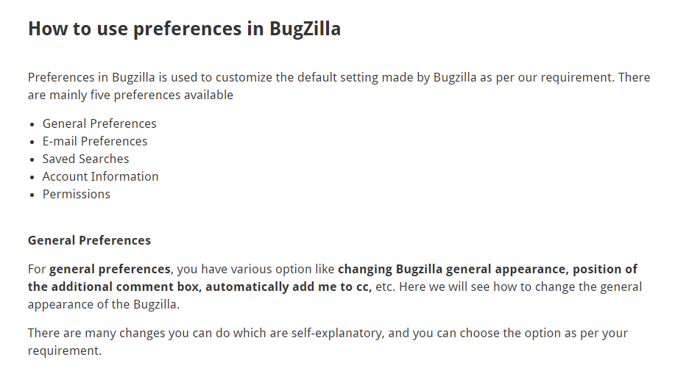

Slide 47
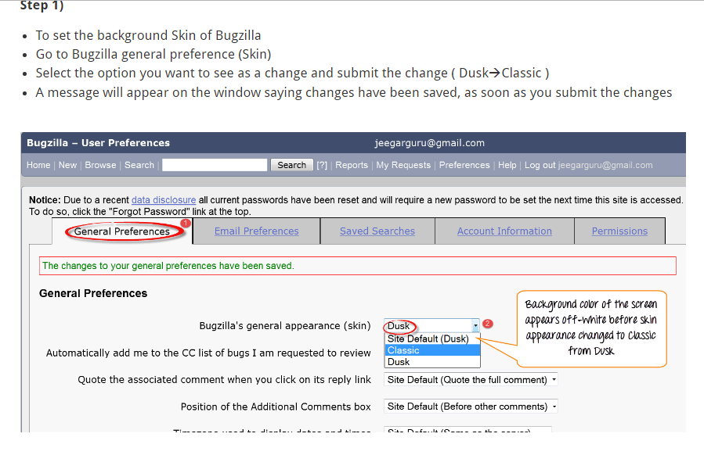

Slide 48
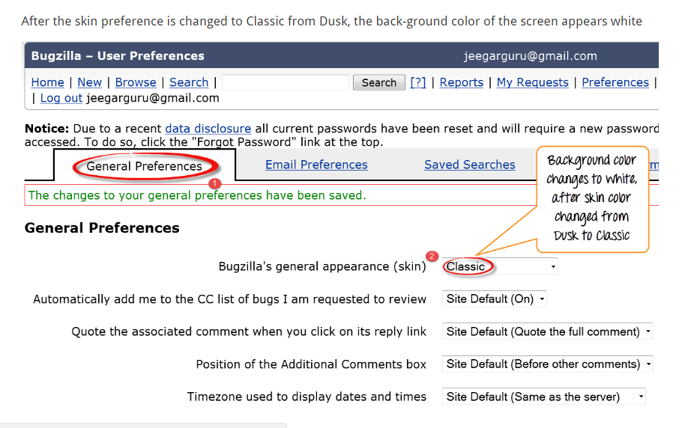

Slide 49
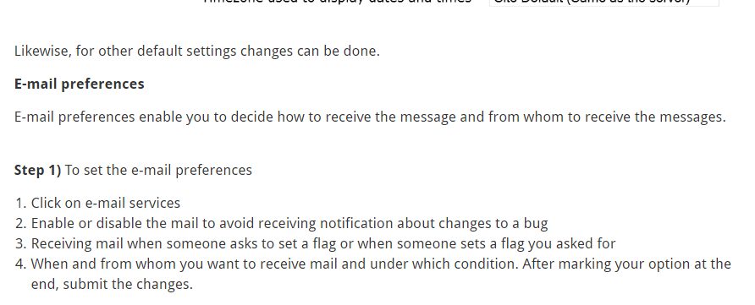

Slide 50
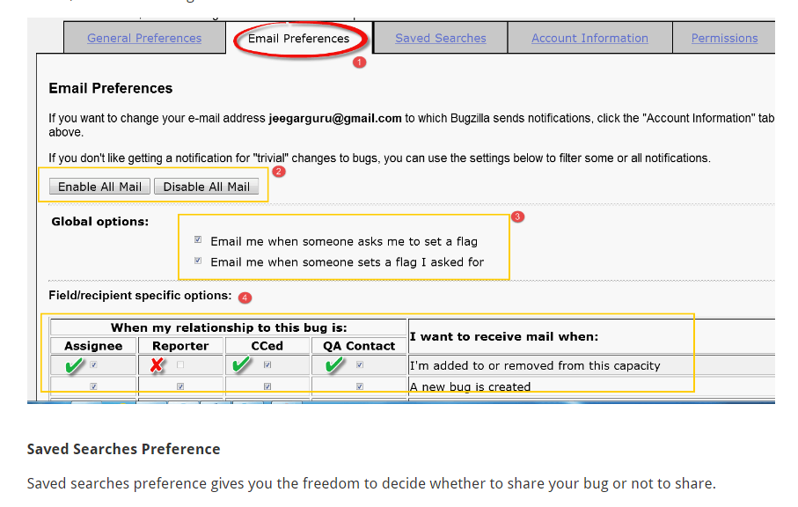

Slide 51
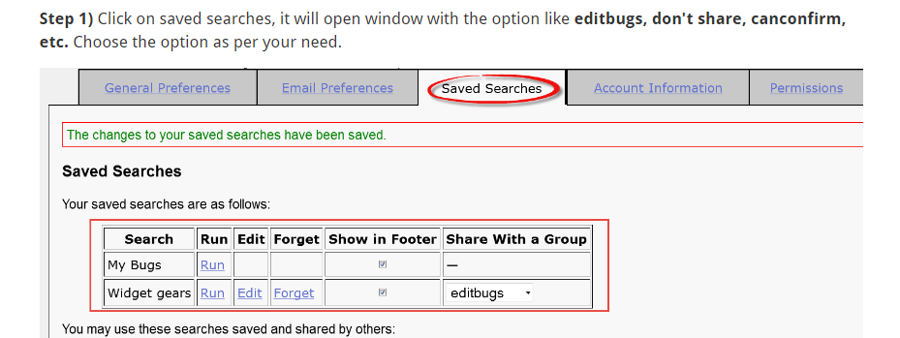

Slide 52
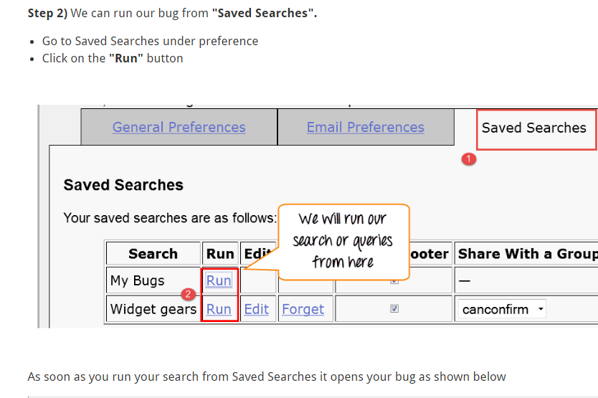

Slide 53
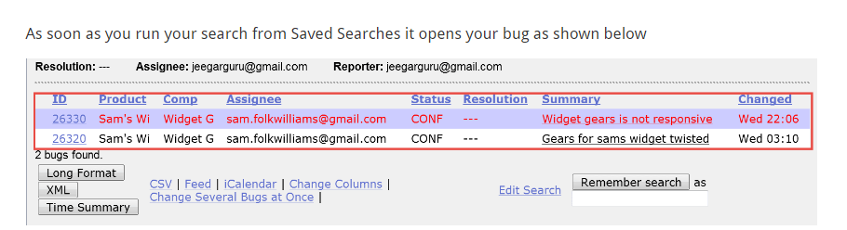

Slide 54
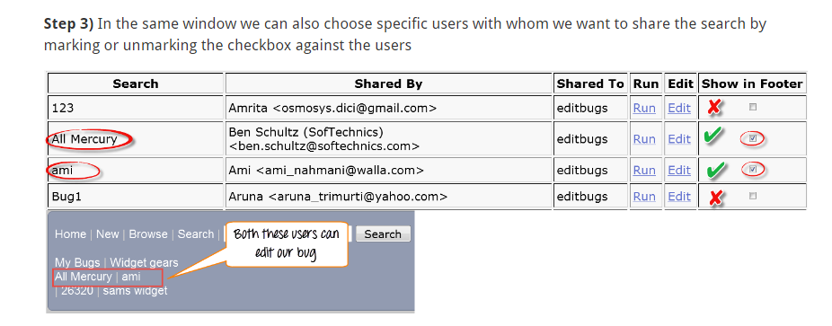

Slide 55

THANK YOU…
Bye friends…..

